Slide 1
Predicting House Prices Using Machine Learning
Development Part 1
TEAM MEMBERS
Karthikeyan Arun Kumar(TL)
Ajay.P
Elakiyan.S
Gladwin Prince
Ajith.P

Slide 2
"Setting the Stage for Success: The Initial Development Phase"
In the world of project management, establishing a strong foundation is akin to setting a course for success.
It's during this initial development phase that we define our purpose, plan our journey, and put the key elements in place.

Slide 3
INTRODUCTION

Slide 4
Project Definition: Laying the Cornerstone
Clarifying Purpose and Objectives
At the heart of successful project development lies a clear and unambiguous definition. This is where we lay the cornerstone for the entire endeavor.
Defining the Project: Project definition involves clarifying the project's purpose, objectives, and scope. It answers the fundamental questions of "What are we trying to achieve?" and "Why is it important?“
Impact on Stakeholders: Clear project definition resonates with stakeholders, helping them understand the project's purpose and aligning their expectations with the intended outcomes.

Slide 5
Stakeholder Analysis

Slide 6
Stakeholder Analysis: Understanding Key Players
In the intricate tapestry of project development, stakeholders play a pivotal role. This phase is dedicated to understanding them.
Who Are Stakeholders? Stakeholders are individuals, groups, or organizations with a vested interest in the project's success. They can be internal (team members) or external (clients, users, regulators, etc.).
Analyzing Stakeholder Roles: Stakeholder analysis involves identifying who they are, what interests they hold, and what their expectations are. By doing so, we can align project goals with stakeholder needs.

Slide 7

Key Objectives:
Gain an understanding of each stakeholder's influence on the project.
Identify potential conflicts or points of alignment.
Establish clear communication channels and expectations.
Ensure that stakeholders' voices are heard and incorporated into the project.

Slide 8
Scope Definition

Slide 9
"Scope Definition: Setting Boundaries for Success"
When it comes to project development, understanding the scope is akin to drawing a map. It tells us where we're headed and what lies along the journey.
Defining the Project Scope: Scope definition involves clearly outlining what the project encompasses and, equally important, what it does not. This is where we establish boundaries for the project.
Clarity and Focus: A well-defined scope brings clarity and focus to the project, helping team members and stakeholders understand the project's limits. This clarity is vital to prevent scope creep, which can lead to delays and increased costs.

Slide 10

Scope Components
The project scope typically includes:
Project objectives and deliverables
Key milestones and timeline
Resources and budget
Constraints and assumptions
Stakeholder roles and responsibilities

Slide 11
Project Planning

Slide 12
Project Planning: Charting the Course
A project's journey is only as good as its plan. This is where we roll up our sleeves and start charting the course for success.
Defining Project Planning: Project planning is the process of identifying, defining, and organizing the tasks, resources, and timeline needed to achieve project objectives.

Slide 13
Key Elements:
Task Breakdown: Break down the project into manageable tasks, creating a roadmap for progress.
Timelines: Establish clear timelines and deadlines for each task to ensure project progress remains on schedule.
Resource Allocation: Allocate necessary resources, including people, technology, and budget, to support task completion.
Risk Assessment: Identify potential risks and develop strategies to mitigate or respond to them.
Quality Control: Detail quality control processes to maintain project integrity.
Communication Plan: Develop a plan for effective communication within the project team and with stakeholders.

Slide 14
Resource Allocation

Slide 15
Resource Allocation: Putting the Right Pieces in Place
A project without the right resources is like a ship without a rudder. In this phase, we ensure that we have the necessary pieces in place for a smooth journey.
Resource Allocation Defined: Resource allocation is the process of assigning and managing the people, technology, and budget needed to support the project's tasks and objectives.
Efficiency and Timeliness: Effective resource allocation ensures that the right resources are available at the right time, reducing delays and optimizing project efficiency.
Role of Project Manager: The project manager plays a pivotal role in resource allocation, coordinating team members, technology, and budget to meet project requirements.

Slide 16
Communication and Coordination: Open and effective communication among team members and stakeholders is crucial to ensure resource allocation is in alignment with project objectives.
Iterative Process: Just like other aspects of initial development, resource allocation may require adjustments as the project evolves and needs change.

Slide 17
Technology Stack Selection

Slide 18
Technology Stack Selection: Building with the Right Tools
In the digital age, technology is the backbone of project development. This phase is dedicated to selecting the tools and platforms that will bring our project to life.
Defining Technology Stack Selection: This is the process of choosing the combination of programming languages, frameworks, databases, and other technologies that best suit the project's requirements.
Iterative Process: Technology stack selection is not static. As the project evolves and new technologies emerge, we may need to revisit and adapt our choices.
Risk Management: Consider how the chosen technologies impact project risks, including potential vulnerabilities and data security.
User-Centric Focus: Keep in mind that the chosen technologies should serve the needs of the project's end-users and stakeholders, ensuring a positive user experience.

Slide 19

Key Considerations:
Project Objectives: The selected technology stack should align with the project's specific goals and requirements.
Scalability: Ensure the chosen technologies can grow with the project as user demand increases.
Compatibility: Technologies should work seamlessly together and integrate with existing systems if necessary.

Slide 20
Team Formation

Slide 21
Team Formation: Assembling the Dream Team
Behind every successful project is a great team. This phase is dedicated to assembling the individuals who will bring the project to life.
Importance of Team Formation: Building the right team is like casting the actors for a successful play. The team is responsible for the project's execution and success.
Roles and Responsibilities: Team formation involves defining the roles and responsibilities of each team member. It answers the questions of who will do what and when.

Slide 22
Team Dynamics: Creating a team with complementary skills and expertise fosters collaboration and efficiency. Team members should understand their roles and how they fit into the larger project.
Communication and Collaboration: Effective communication and collaboration are key. Establish communication channels and a culture of sharing ideas and feedback.
Leadership: Appoint or identify leaders who can guide the team, make decisions, and keep the project on track.
Team Building: Team formation isn't just about roles; it's also about building a sense of camaraderie and shared purpose among team members.
Iterative Approach: Just like other project aspects, team formation can be iterative. As project needs evolve, the team may need adjustments.

Slide 23
Prototyping and MVP

Slide 24
Iterative Development for a Successful Product
The early stages of project development are an ideal time to test ideas and concepts before fully committing. This is where prototyping and Minimum Viable Product (MVP) come into play.
Prototyping Defined: Prototyping involves creating a preliminary, simplified version of the product to test ideas and features. It allows for user feedback and concept validation without fully developing the product.
MVP Defined: The Minimum Viable Product is the smallest version of the product that provides value to users. It allows for early market entry and user feedback.

Slide 25

Key Benefits:
User Feedback: Both prototyping and MVPs enable us to gather user feedback early in the development process.
Concept Validation: Prototyping helps validate concepts and features, reducing the risk of building something that users won't find valuable.
Risk Mitigation: By testing early, we can identify and mitigate potential issues or challenges.
Cost and Time Savings: It's more cost-effective to make changes during the prototype or MVP phase than after full development.

Slide 26
Data Gathering and Analysis

Slide 27
Data Gathering and Analysis: Insights for Informed Decisions
In today's data-driven world, information is power. This phase is dedicated to gathering and analyzing data to make informed decisions that shape the project's direction.
Data Gathering Defined: Data gathering involves collecting relevant information, including user feedback, performance metrics, and market data, to better understand the project's context.
Importance of Data Analysis: Data analysis is the process of making sense of the gathered information. It provides insights that guide project decision-making and improvements.

Slide 28
Key Aspects:
User Feedback: User insights gathered through prototypes and MVPs.
Performance Metrics: Metrics like response times, user engagement, and error rates to assess the project's performance.
Market Data: Understanding market trends and competitor insights.
Behavioral Data: Analyzing user behavior within the project, including interactions and preferences.

Slide 29
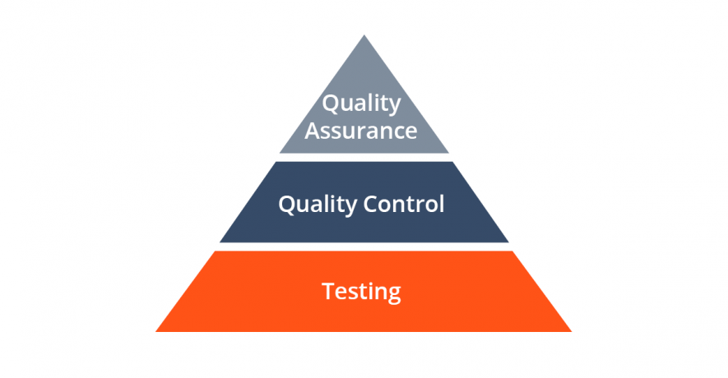
Testing and Quality Assurance

Slide 30
Testing and Quality Assurance: Ensuring a Reliable Product
The reliability of a project is a non-negotiable aspect of success. In this phase, we explore the importance of testing and quality assurance to ensure a robust and dependable product.
Testing and Quality Assurance Defined: Testing is the process of evaluating a project to identify and resolve issues or errors. Quality assurance encompasses all processes that ensure the project meets the required quality standards.
Documentation: It's important to maintain detailed records of testing procedures, identified issues, and their resolutions. This documentation aids in accountability and future reference.

Slide 31
CONCLUSION

Slide 32
In the journey of initial project development, we've explored the critical steps and strategies that form the bedrock of project success. We've witnessed the importance of laying a strong foundation to ensure a smooth and fruitful project journey.
From project definition and stakeholder analysis to technology stack selection and user-centered design, every phase contributes to the project's success. The iterative nature of these processes allows for adaptability and alignment with evolving project needs.
We've highlighted the significance of user-centric design, rigorous testing, and feedback collection in enhancing project quality, reliability, and user satisfaction. Continuous improvement is not just a concept but a practice deeply embedded in the project's DNA.

Slide 33
As we conclude, remember that the journey doesn't end here. With the insights gained from project reviews and feedback, we set our milestones and continue to track progress, adapting as needed.
The foundations of initial development are the cornerstone for a successful project. Embrace these principles, prioritize user needs, and keep the spirit of adaptability alive. Your project's success lies in the journey you undertake from here.

Slide 34
THANK YOU
This presentation idea provides a comprehensive overview of the initial development steps in a project, from defining the project's purpose to addressing challenges and solutions. Each slide can be further detailed to provide a deep understanding of the early stages of project development.

